Slide 1






SUHFT Medical Devices Training Model
Pat Taw MEMS Medical Equipment Training Co-ordinator
Paul Goodfellow MEMS General Manager

Slide 2
The Job Role Matrix
Training Delivery
Recording & Evidence
Monitoring & Compliance
Training by exception
Why this works!
Progression

Slide 3
The Job Role Matrix
Identification of staff groups.
Inventory of equipment used by staff group.
Risk assessment of equipment to determine training frequency & review period.
Gap analysis and self assessment.
Frequent users require less training

Slide 4
Job Role Matrix

Slide 5
Training Delivery
Supplier led, cascade.
Key trainer, end user, self verification.
Face to face / peer discussion / bespoke study days/ ward based sessions (95%).
Refresher – normally self assessment via METC.

Slide 6
Lesson Plan

Slide 7
Recording & Evidence
Training is recorded on Competency Form and held by the member of staff
The Trust central database, iLearn is populated and included refresher training reminder

Slide 8
Competency Form

Slide 9
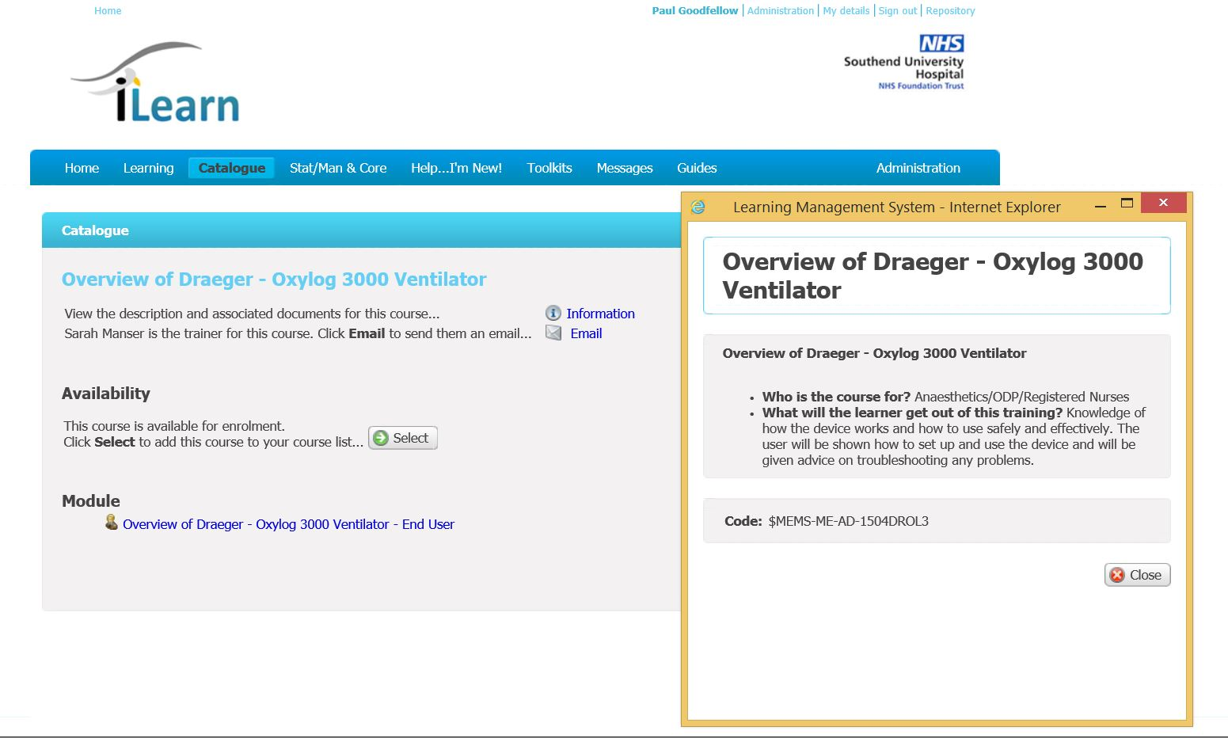

Slide 10
Monitoring & Compliance
Monitoring is a four stage process:
1. Agreed JRM
2. Gap analysis to identify training needs
3. Active training
4. Population of iLearn
Each stage is measured to determine the compliance
Currently unable to provide a complete Trust wide training compliance until iLearn is fully populated.

Slide 11
Training by exception
New equipment Acceptance test process
Incident reports – Trust via Datix
Event reports – MEMS via Medusa
User rotation i.e. internal incident
New staff
Staff returning from long term leave
Response to guidance, safety alerts
Ad hoc requests

Slide 12
Why this works!
Based on risk – keep it simple
Achievable – Staff engagement
Central, accessible bespoke database
Training is integral to medical equipment management
Traceability / auditable – improvement

Slide 13
Progression
linking on-line training material to iLearn course
Competency forms attached to iLearn with electronic self verification
Staff account on iLearn will identify the equipment to that member of staff rather than the job role
Development across Essex

